Slide 1
DATABASES
Jyh-haw Yeh
Dept. of Computer Science
Boise State University

Slide 2
What is a database?
A collection of related data, stored in a structured way.
It represents some aspects of real world.
Databases are created and maintained by a DBMS (DataBase Management System).
Well known DBMS: Oracle, Informix, MySQL…

Slide 3
DataBase Management Systems
DBMS facilitates the processes of defining, constructing, and manipulating databases.
  Defining a database: specify data type, structures and constraints for the data.
  Constructing a database: store data on some storage medium.
  Manipulating a database: querying and updating.

Slide 4
Database Design Process
Talk to clients to get the application’s requirements and constraints.
Design the database using high level conceptual data model, such as ER and EER.
Use a mapping algorithm to convert ER or EER to relational data model.

Slide 5
Database Design Process (cont.)
Use the normal forms and functional dependencies to fine tune the design.
Use some DBMS to create and maintain the database.

Slide 6
Designing a Company Database
Client’s requirements and constraints:
The company is organized into DEPARTMENTS, each department has a unique Name, a unique Number, and a particular EMPLOYEE as a MANAGER. We keep track of the Start Date of the MANAGER. A department may have several Locations.
A department CONTROLS some PROJECTS. A PROJECT has a unique Name, a unique Number, and a single Location.
We store each employee's Name, Ssn, Address, Salary, Sex, and Birth Date. An employee is ASSIGNED to one department but may WORK ON several projects, which are not necessarily CONTROLLED by the same department. We store the number of Hours per week that an employee works on each project. Each employee has a direct SUPERVISOR.
We want to keep track of the DEPENDENTS of each employee for insurance purposes. We keep each dependent's First Name, Sex, Birth Date, and Relationship to the employee.

Slide 7
Designing a Company Database
Design the database by ER Model
  Entity type: a type of real world entities.
  Relationship type: relation between entities.
  Attribute: describes the properties of entities.
Next page shows a possible design of the company database in the ER model.

Slide 8
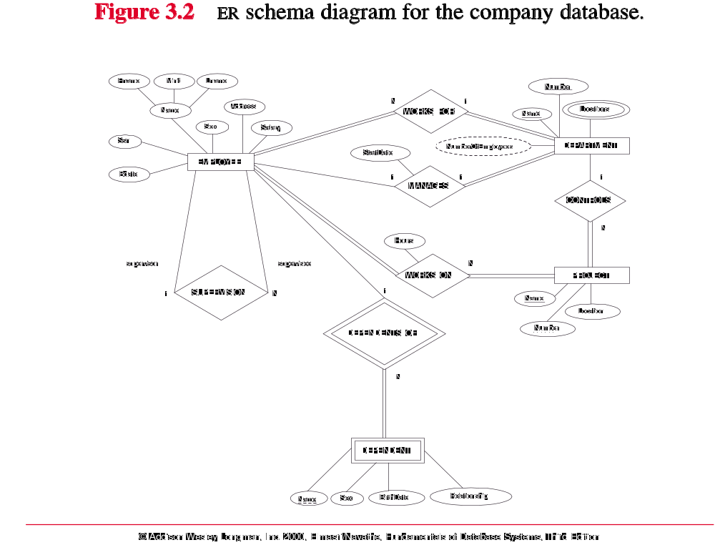

Slide 9
Designing a Company Database
Map ER model to relational model:
  A mapping algorithm exists for the mapping.
  A relational database is a set of tables (or relations).
  The table heading is a list of attributes.
  Next page shows the result after mapping of the company database in a relational model.

Slide 10
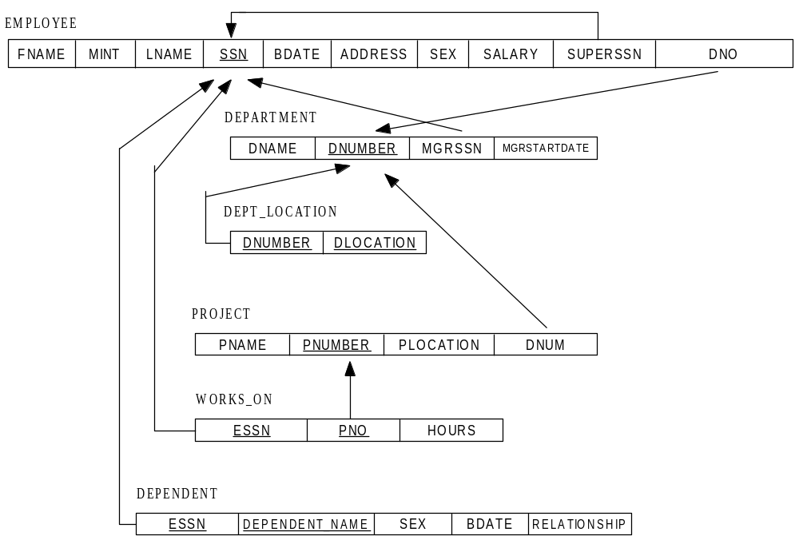

Slide 11
Designing a Company Database
Using functional dependency and normal forms to fine-tune the database design.
  The objectives of this step:
  Clear semantics to attributes.
  Reduce the NULL values.
  Reduce data redundancy.
  Avoid generate spurious tuples.
  Examples: Figures 14.4, 14.5, 14.6
  http://cs.boisestate.edu/~jhyeh/teach/cs410_bookfigures_ch14.pdf

Slide 12
Implement the Company Database in a DBMS
Using SQL-DDL to create database:
  The DDL for the company example is shown in http://cs.boisestate.edu/~jhyeh/teach/cs410_bookfigures_ch08.pdf
  The company database will be created if a DBMS executes the above DDL.
  Next, using the load utility, provided by the DBMS, to load data into the database. http://cs.boisestate.edu/~jhyeh/teach/cs410_bookfigures_ch07.pdf

Slide 13
Manipulating the Company Database
Use SQL-DML to update or retrieve information from the database.
Update, for example:
Insert a new employee, Delete a department, Update someone’s salary….
Retrieve, for example:
Retrieve the names of employees who work on multiple projects……

Slide 14
SQL-DML Examples
insert into EMPLOYEE
values (‘Richard’, ‘K’, ‘Jones’, ‘987654321’, ‘1972-08-25’, ‘101 University Dr., Boise, ID’, ‘M’, 55000, ‘888665555’, 1);
delete from DEPARTMENT
where DNAME = ‘Research’;
update EMPLOYEE
set SALARY = SALARY * 1.1
where DNO = 5;

Slide 15
SQL-DML Example
Query: retrieve the names of employees who work on multiple projects.
select FNAME, LNAME
from EMPLOYEE, WORKS_ON
where SSN = ESSN and
group by SSN
having count(*) > 1;
FNAME | LNAME
John | Smith
Joyce | English
Franklin | Wong
Alicia | Zelaya
Ahmad | Jabbar

Slide 16
SQL-DML Example
Query: retrieve the names of employees in Research department.
select FNAME, LNAME
from EMPLOYEE, DEPARTMENT
where DNO = DNUMBER and
DNAME = ‘Research’;
FNAME | LNAME
John | Smith
Franklin | Wong
Ramesh | Narayan
Joyce | English

